Slide 1

Lab Research Report
Adivisor: Peng-Shen, Chen
Student: Yu-Chun, Hung

Slide 2
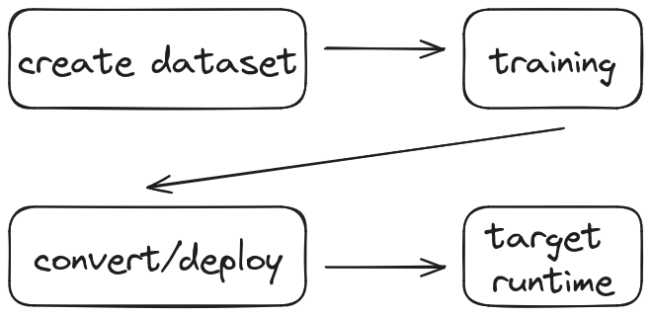
Path of Deep Learning

Slide 3
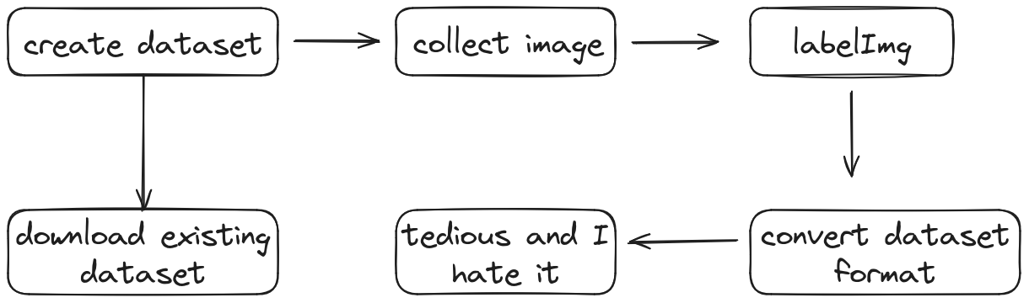
Dataset

Slide 4
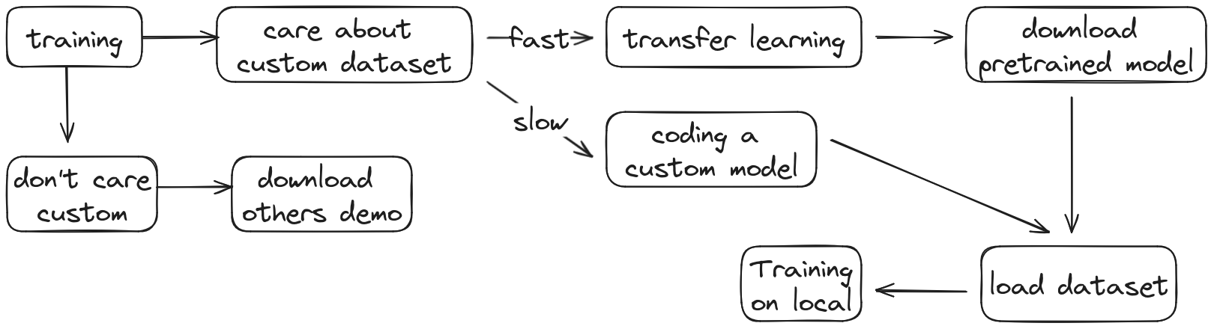
Training

Slide 5
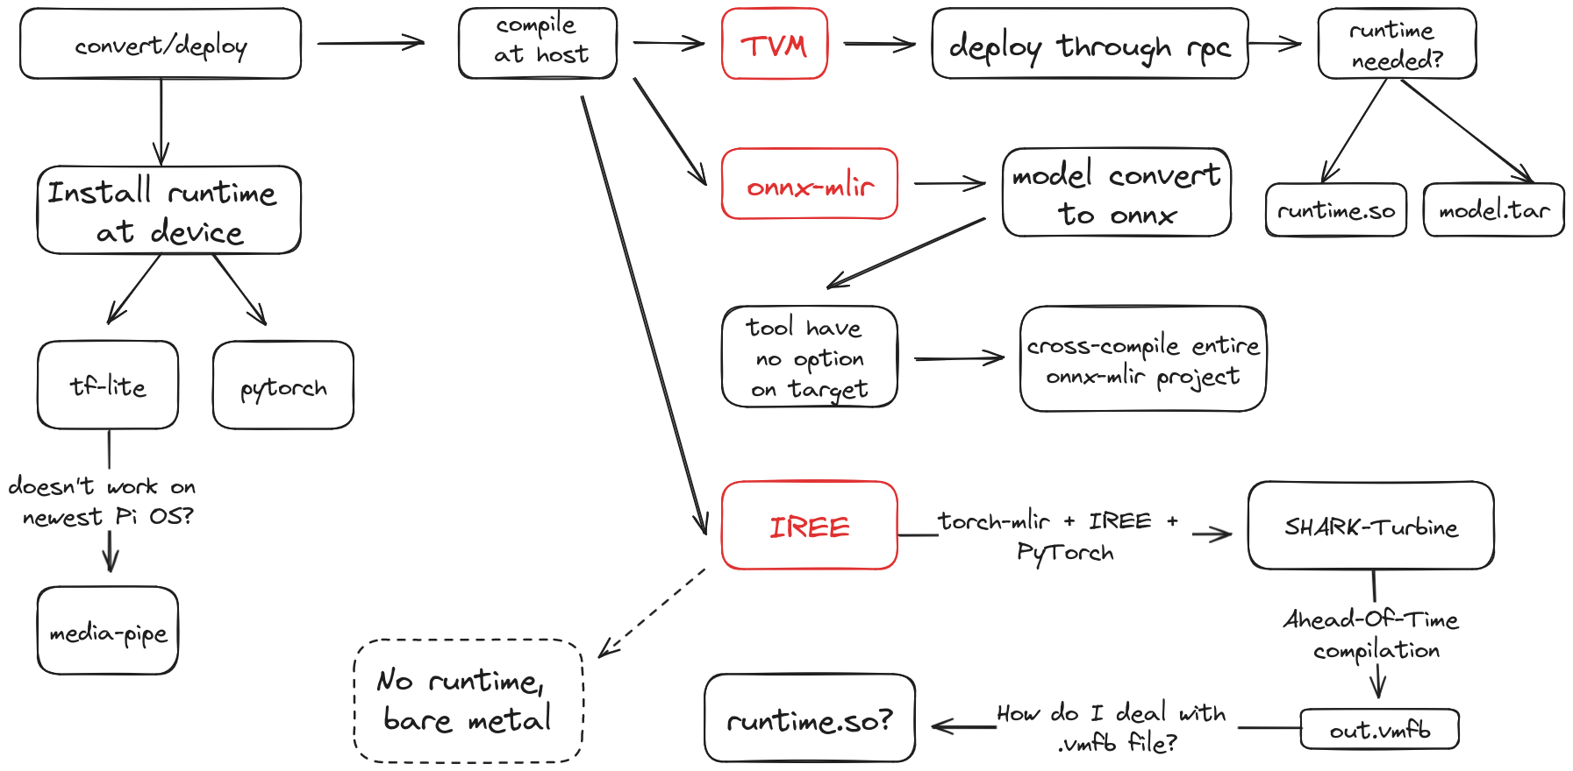
Convert/Deploy

Slide 6
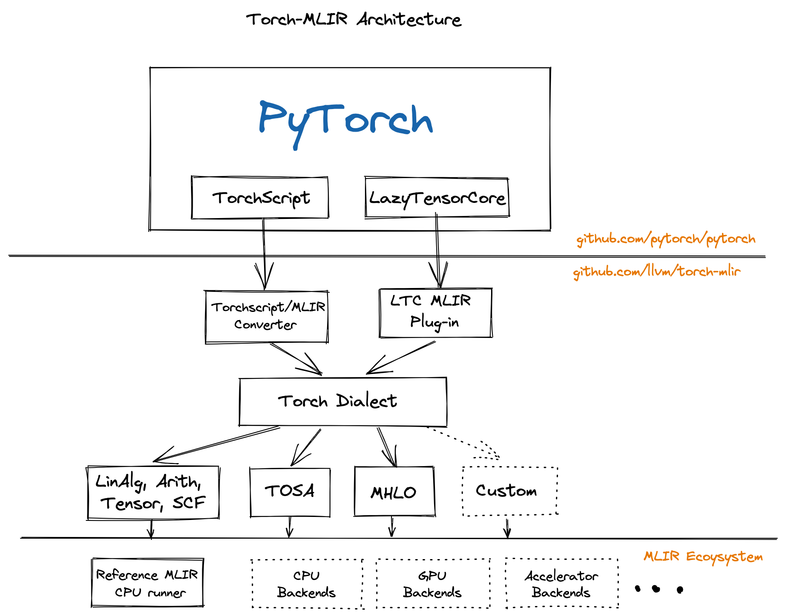
Convert/Deploy (TorchMLIR)

Slide 7
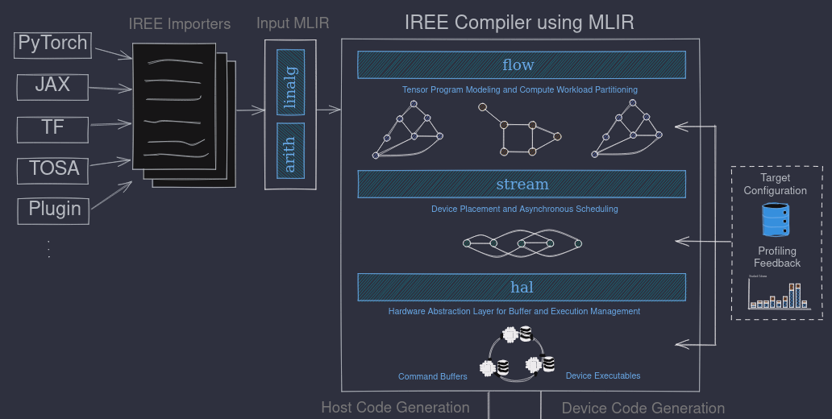
Convert/Deploy(IREE)

Slide 8
Convert/Deploy(IREE)

Slide 9
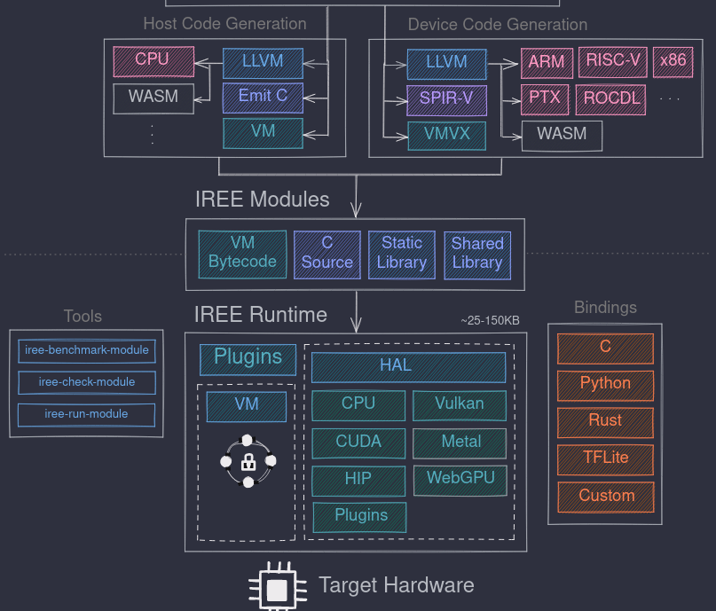
Convert/Deploy(IREE)

Slide 10
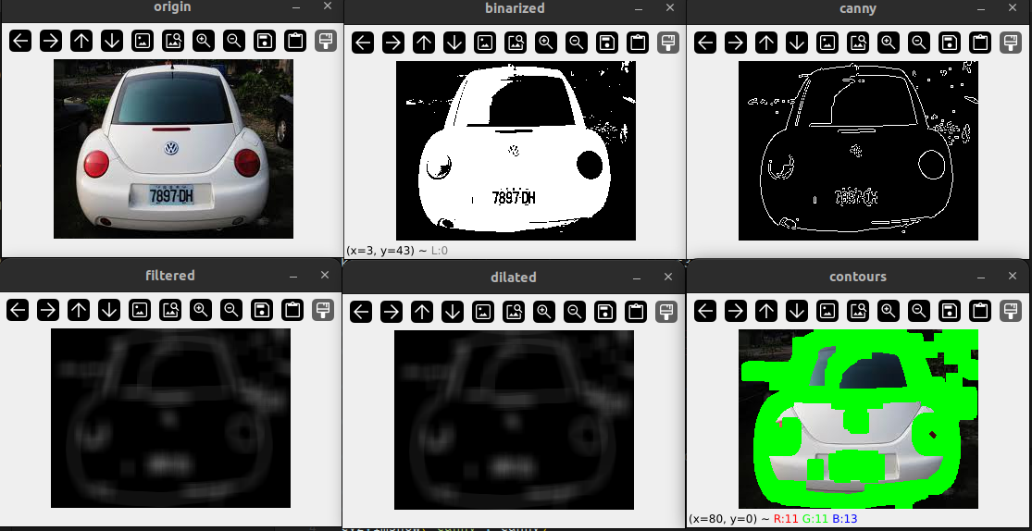
Plate Recognision

Slide 11
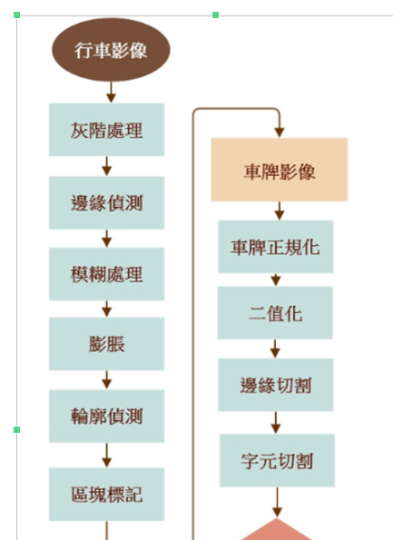
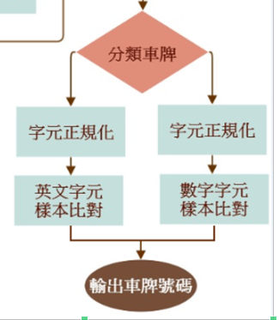
Plate Recognision

Slide 12
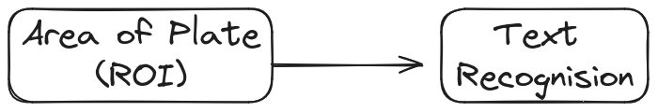
Plate Recognision

Slide 13
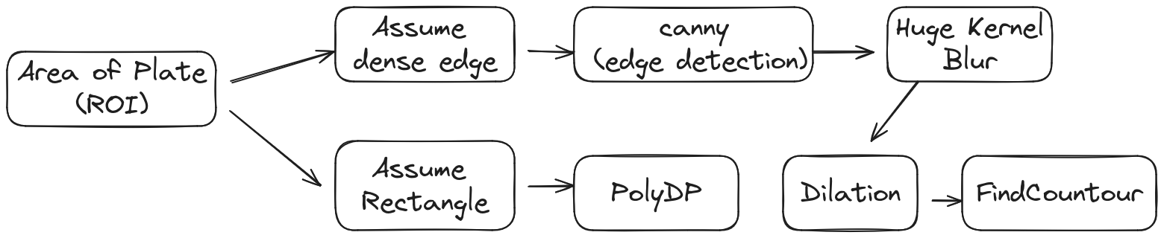
Plate Recognision

Slide 14
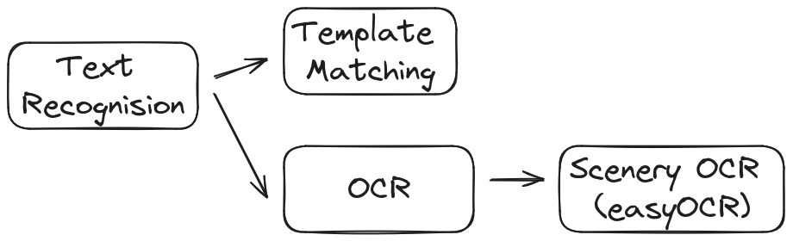
Plate Recognision

Slide 15
Course Componet Requirment
USB-miniUSB charger: 10
SDCard reader: USB: 10, Normal: 14
SDCard: 37
Pi3: 30+, Pi4: 5
Do we need HDMI?

